Slide 1
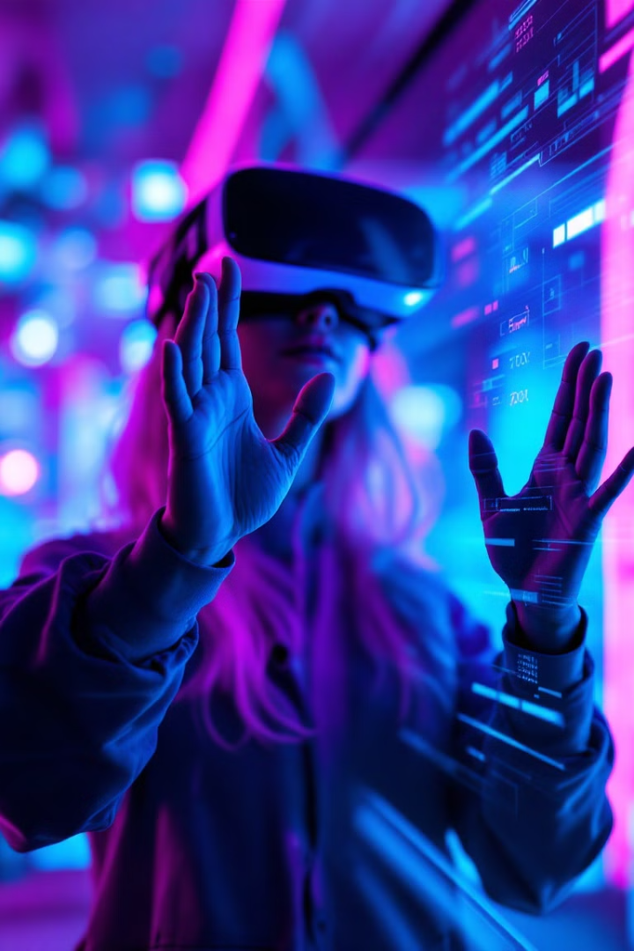

Unlocking Intuitive Interaction: A Journey into Hand Gesture Recognition
This presentation outlines the development of a hand gesture recognition system, aiming for intuitive human-computer interaction. We'll cover the vision, tools, data collection, architecture, training, deployment, results, and future directions of this project. The goal is to demonstrate how natural hand gestures can control technology seamlessly, opening new possibilities in gaming, VR, and accessibility.
by Aiyede Sunday

Slide 2

Assembling the Toolbox for Innovation
The foundation of our gesture recognition system relies on a carefully selected set of tools, each contributing to the project's success.
Core Libraries
Deep Learning
cv2, numpy, mediapipe, and tensorflow were the key Python libraries, providing essential image processing and machine-learning capabilities.
We utilized the tensorflow.keras library for constructing and training deep learning models, allowing us to create powerful and accurate gesture-recognition algorithms.
Programming Language
Python was used as the primary language. Python's flexibility, extensive libraries, and ease of use made it ideal for developing complex gesture recognition.

Slide 3
Data Collection: Teaching the System to "See"
At the heart of our project, a critical step was gathering a comprehensive dataset. The GestureDataCollector class automated this process, capturing hand gestures to train the system.
Gesture Categories
Dynamic Capture
Open Hand
Each gesture was captured in a series of 300 images, cropped dynamically to focus on the hand, and resized to 224x224 pixels for consistency.
Fist
Point
Peace
Thumbs Up

Slide 4
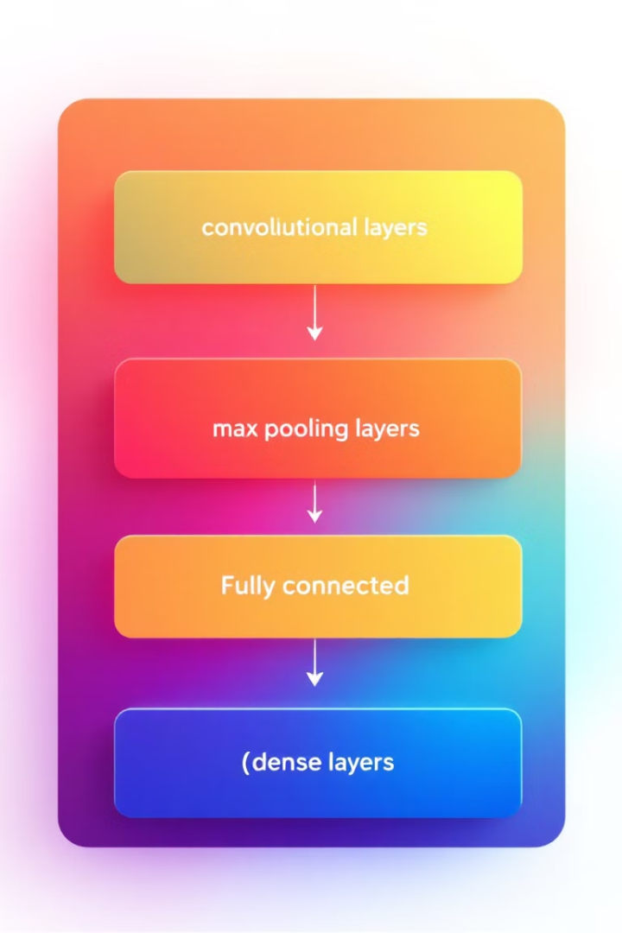
Architecting Intelligence: Building the Neural Network
The neural network is structured to extract spatial features, reduce dimensions, encode high-level features, and prevent overfitting. The architecture is designed for optimal performance and accuracy.
Convolutional Layers
MaxPooling Layers
Three convolutional layers with increasing filters (32, 64, and 128) extract spatial features from the input images.
MaxPooling layers reduce the dimensions of the feature maps, preserving the most important features while reducing computational load.
Dropout Regularization
Dropout regularization prevents overfitting by randomly deactivating neurons during training, improving the model's generalization ability.

Slide 5
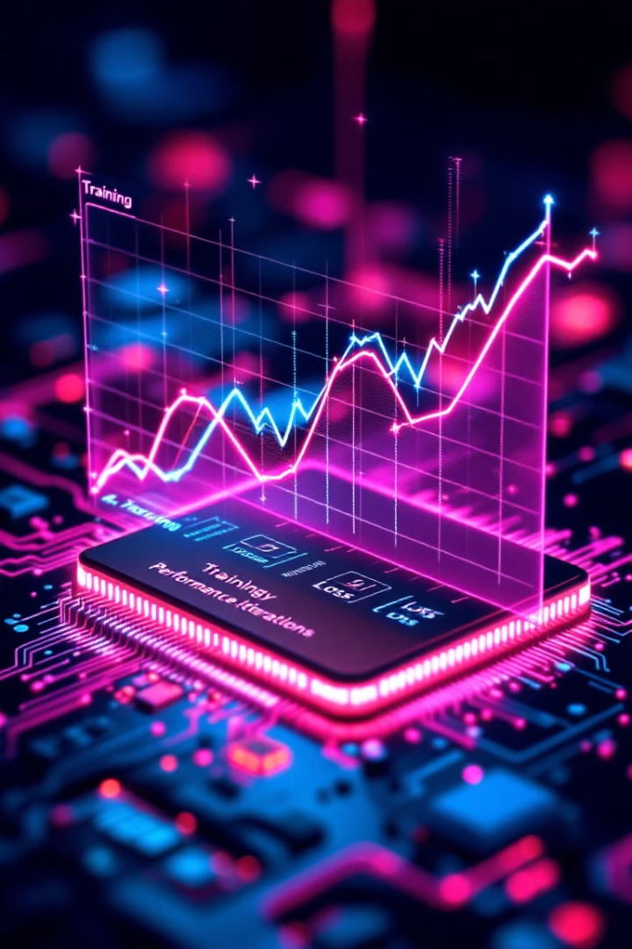

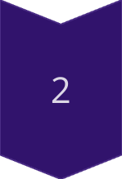
Training the Model: From Novice to Expert
The model was trained over 20 epochs using the adam optimizer and an 80/20 train-test split. The training process achieved near-perfect accuracy.
Epoch 1
The model achieved an initial accuracy of 52.62%.
Epoch 20
The model reached 99.91% training accuracy and 100% validation accuracy.

Slide 6



Deploying the Model: Real-Time Gesture Recognition
With the model trained and saved, the GestureRecognizer class enables real-time recognition via a webcam.
Real-Time Recognition
Gestures are identified and displayed with confidence scores in real-time.
Smoothing Mechanism
Practical Application
Predictions are combined over a sliding window to improve stability.
The model uses a webcam to display real-time identification.
2
1
3

Slide 7
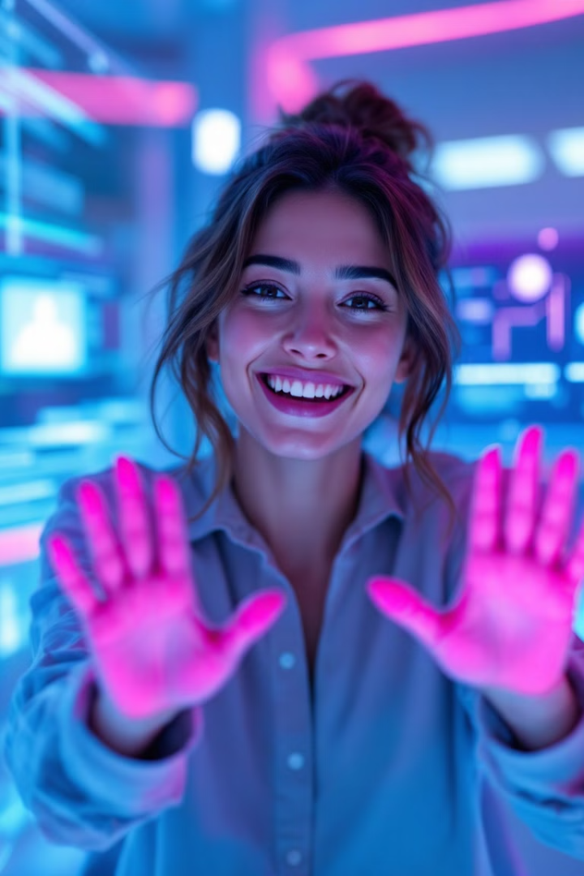

Results and Impact: A Promising Outcome
The system successfully classified hand gestures in real-time, achieving high precision on validation data. This has practical applications in various domains.
High Precision
Gaming
Virtual Reality
Enhanced gaming experiences through gesture control.
Near-perfect performance on validation data.
Immersive VR interactions using natural hand movements.
Accessibility Tools
Improved accessibility for individuals with disabilities.

Slide 8



Reflections and Future Horizons: Expanding the Possibilities
While the project achieved its initial goals, there are several avenues for future refinement to further improve the gesture recognition model.
Scalability
1
Adding more gesture categories.
Generalization
2
Testing in diverse environments.
Optimization
3
Improving performance for mobile and embedded systems.

